Slide 1
Administrative Law
Part 5: Agency Action
Lecture 1: The Administrative Procedure Act (APA)

Slide 2
Administrative Procedure Act (APA)
Few effective constitutional constraints on agencies (see, e.g., Mathews v. Eldridge)
Modern Congress subject to few effective constitutional limitations on transfer (delegation) of power to agencies (see, e.g., Mistretta)
While few constitutional constraints have practical impact on modern agency action, statutory constraints have substantial impact
Courts hold agencies strongly accountable to statutory constraints on agency action
This may, in part, be out of a desire to defer to Congress when applying constitutional limitations and maintain a common baseline

Slide 3
Administrative Procedure Act
The APA is one (probably the most) common statutory constraint on agency action
Primarily focused on agency procedure, but can also result in having substantive effect
Other sources include:
Organic statutes
Agency regulations
Agency practice (historical patterns)
Presidential directives
(obviously, also, the Constitution, but see above)

Slide 4
Administrative Procedure Act
5 U.S.C. §§ 551, 553–559, 701–706
Federal Law, passed in the mid-1900s which codifies rules of procedure governing (almost) all Federal agencies
Includes a definition of agencies (§ 551(1)):
“[A]gency means each authority of the Government of the United States, whether or not subject to review by another another, but does not include – ”
Congress, the Courts, state/territorial/D.C. governments, military courts martial, military commissions, military authority during time of War (§§ 551(1)(A) – (D), (F) – (G))

Slide 5
Administrative Procedure Act
14 sections, 4 (categories) of which we discuss:
§ 551: definitions (covered generally)
§ 553: rulemaking (when agencies write rules)
§ 554: adjudication (when agencies enforce rules)
§ 556-57: requirements for “formal” proceedings
§ 702-05: judicial review (generally)
§ 706: scope/requirements for judicial review

Slide 6
Administrative Procedure Act
Divides agency action along two axes:
Formal vs. informal
Rulemaking vs. adjudication
(Also, remember, includes “non-binding” agency actions that are neither strictly rulemaking nor adjudication, such as research)

Slide 7
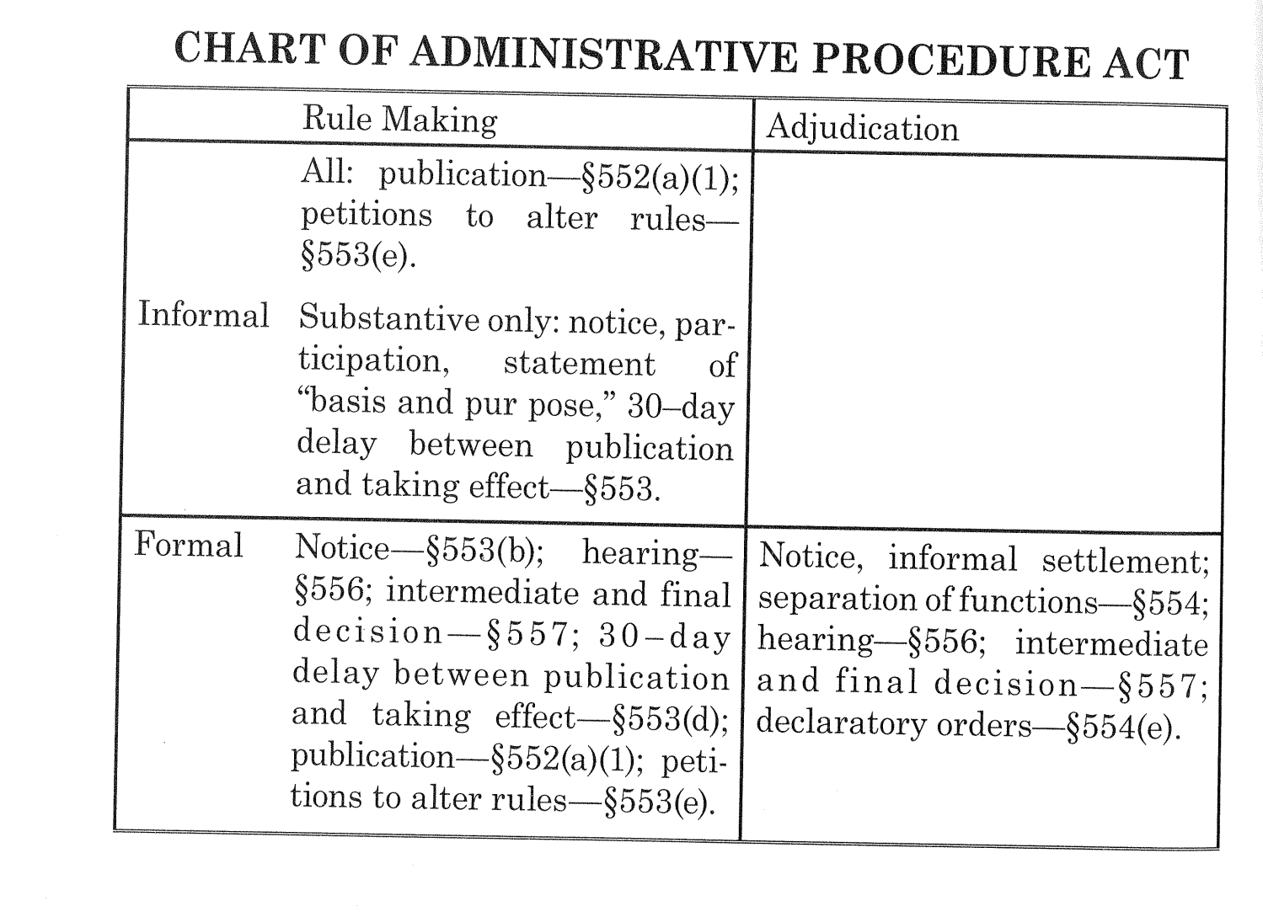
Administrative Procedure Act
(Taken from Gelhorn and Byse's Administrative Law (11th ed.), p. 52.)

Slide 8
Rulemaking
Formal vs. Informal Rulemaking
Formal rulemaking requires elaborate, trial-like procedures, and regulations adopted pursuant to formal rulemaking must be based on the evidence produced at those hearings
Question – what does this remind you of?
Informal rulemaking requires only three steps:
(1) Notice of Proposed Rulemaking
(2) Comment Period for “interested persons”
The agency must “give interested persons an opportunity to participate in the rule making through submission of written data, views, or arguments with or without opportunity for oral presentation.” APA § 553(c)
(3) Statement of Basis and Purpose (explaining reasoning behind adoption of final rule)

